Slide 1
HTML

Slide 2
HTML Forms

Slide 3
The <form> element
The <form> element formally defines a form and attributes that determine the form's behavior.
Warning: It's strictly forbidden to nest a form inside another form. Nesting can cause forms to behave in an unpredictable manner, so it is a bad idea.

Slide 4
<fieldset> and <legend> elements
The <fieldset> element is a convenient way to create groups of widgets that share the same purpose, for styling and semantic purposes.
You can label a <fieldset> by including a <legend> element just below the opening <fieldset> tag.
The text content of the <legend> formally describes the purpose of the <fieldset> it is included inside

Slide 5
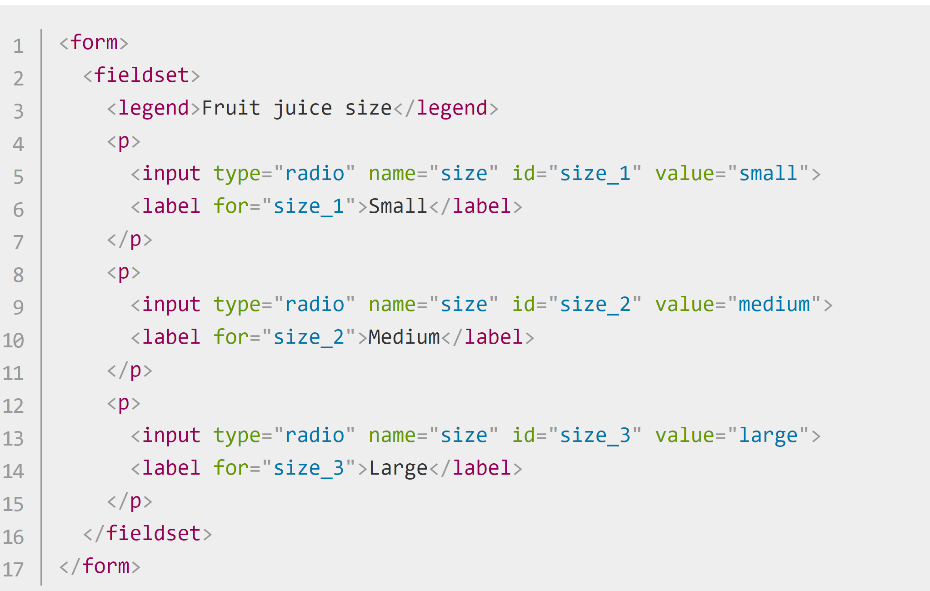
<fieldset> and <legend> elements
Each time you have a set of radio buttons, you should nest them inside a <fieldset> element.

Slide 6
<fieldset> and <legend> elements
Ideally, long forms should be spread across multiple pages, but if a form is getting long and must be on a single page, putting the different related sections inside different fieldsets improves usability.

Slide 7
<label> element
The <label> element is the formal way to define a label for an HTML form widget.
Another advantage of properly set up labels is that you can click or tap the label to activate the corresponding widget.
This is useful for controls like text inputs, where you can click the label as well as the input to focus it, but it is especially useful for radio buttons and checkboxes
The <label> is associated correctly with the <input> via its for attribute (which contains the <input> element's id attribute)

Slide 8
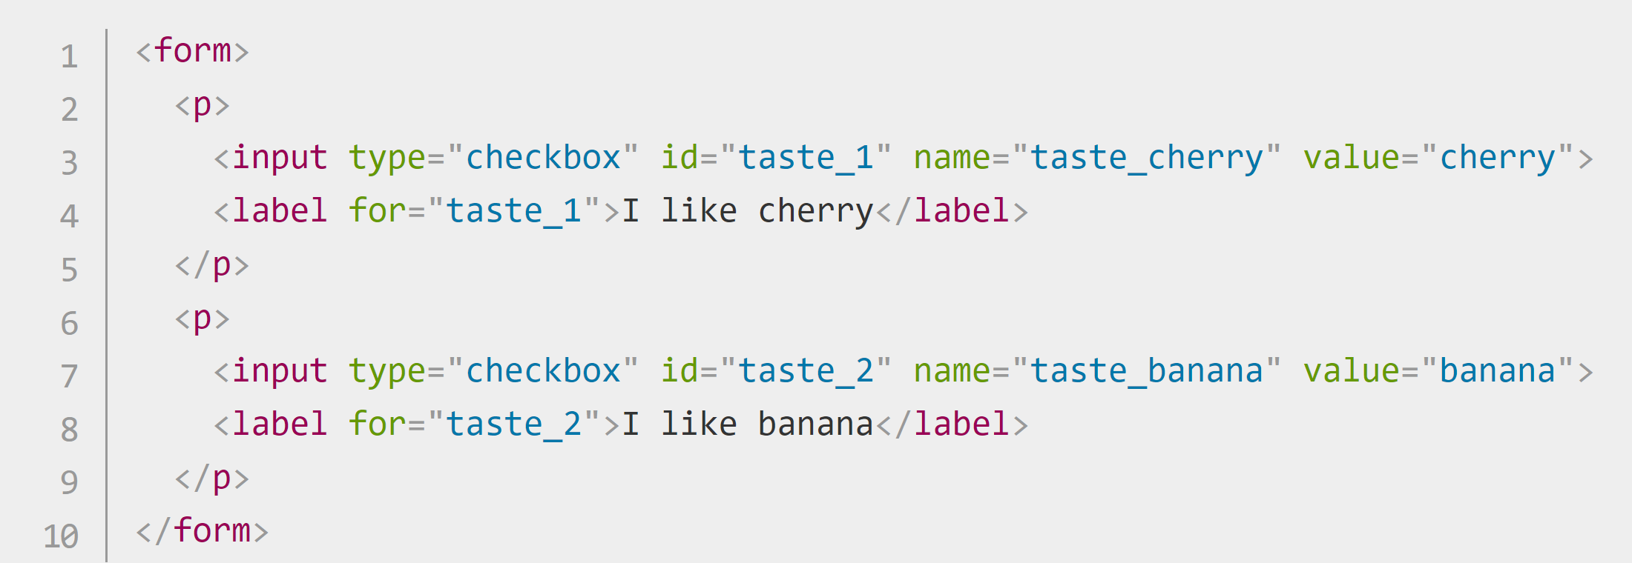
<label> element
For example, clicking on the "I like cherry" label text in the example below will toggle the selected state of the taste_cherry checkbox:

Slide 9
Text input fields
Text <input> fields are the most basic form widgets.
They are a very convenient way to let the user enter any kind of data.
All basic text controls share some common behaviors:
They can be marked as readonly (the user cannot modify the input value but it is still sent with the rest of the form data) or disabled (the input value can't be modified and is never sent with the rest of the form data).
They can have a placeholder; this is text that appears inside the text input box that should be used to briefly describe the purpose of the box.

Slide 10
Text input fields
All basic text controls share some common behaviors:
They can be constrained in size (the physical size of the box) and maxlength (the maximum number of characters that can be entered into the box).
They can benefit from spell checking (using the spellcheck attribute), if the browser supports it.
Note: The <input> element is unique amongst HTML elements because it can take many different forms depending on its type attribute value.
It is used for creating most types of form widgets including single line text fields, time and date controls, controls without text input like checkboxes, radio buttons and color pickers, and buttons.

Slide 11
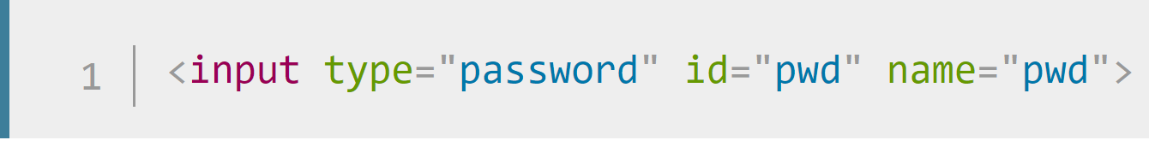
Password field
One of the original input types was the password text field type:
The password value doesn't add any special constraints to the entered text, but it does obscure the value entered into the field (e.g. with dots or asterisks) so it can't be easily read by others.

Slide 12
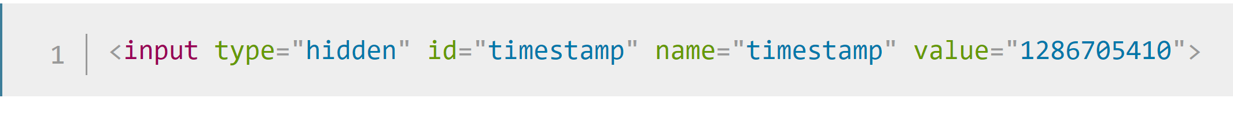
Hidden Content
Another original text control is the hidden input type.
This is used to create a form control that is invisible to the user, but is still sent to the server along with the rest of the form data once submitted — for example you might want to submit a timestamp to the server stating when an order was placed.
Because it is hidden, the user can not see nor intentionally edit the value, it will never receive focus, and a screen reader will not notice it either.

Slide 13
Checkable items: checkboxes and radio buttons
Checkable items are controls whose state you can change by clicking on them or their associated labels.
There are two kinds of checkable item: the check box and the radio button.
Both use the checked attribute to indicate whether the widget is checked by default or not.

Slide 14
Checkable items: checkboxes and radio buttons
Check box
A check box is created using the <input> element with a type attribute set to the value checkbox.
Including the checked attribute makes the checkbox checked automatically when the page loads.
Clicking the checkbox or its associated label toggles the checkbox on and off.

Slide 15
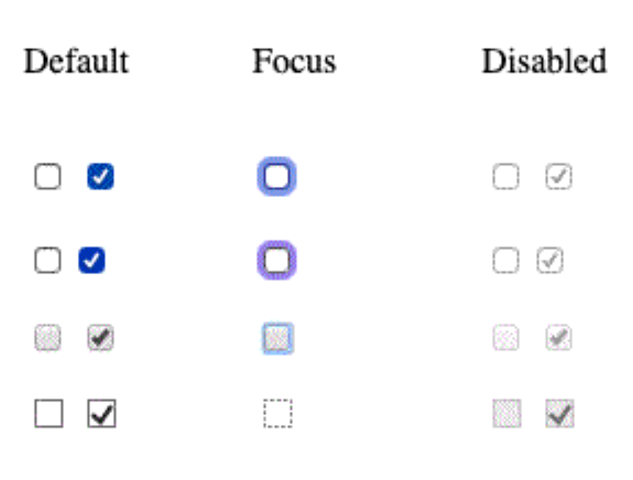
Checkable items: checkboxes and radio buttons
Check box
The following screenshots show default, focused and disabled checkboxes.
A check box is created using the <input> element with a type attribute set to the value checkbox.
Note: Any checkboxes and radio buttons with the checked attribute on load match the :default pseudo class, even if they are no longer checked. Any that are currently checked match the :checked pseudoclass.

Slide 16
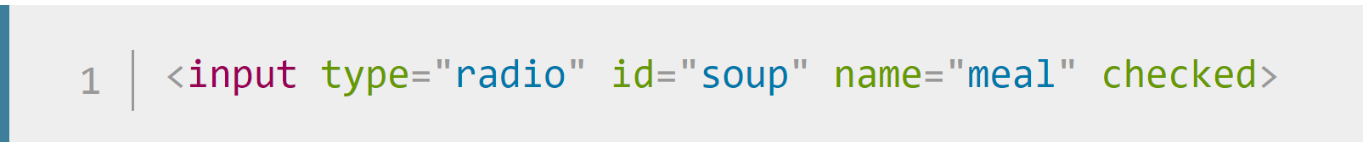
Checkable items: checkboxes and radio buttons
Radio Button
A radio button is created using the <input> element with its type attribute set to the value radio:
Several radio buttons can be tied together.
If they share the same value for their name attribute, they will be considered to be in the same group of buttons.
Only one button in a given group may be checked at a time; this means that when one of them is checked all the others automatically get unchecked.

Slide 17
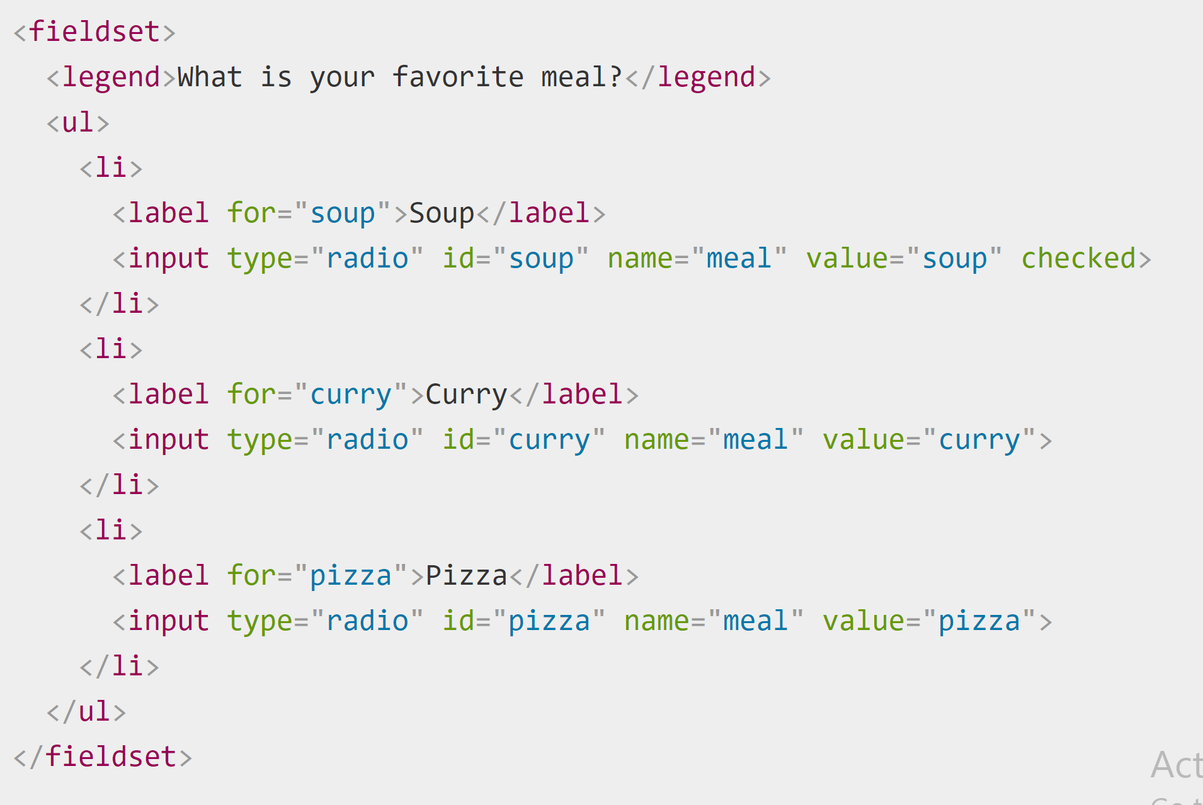
Checkable items: checkboxes and radio buttons
Radio Button
When the form is sent, only the value of the checked radio button is sent.
If none of them are checked, the whole pool of radio buttons is considered to be in an unknown state and no value is sent with the form.
Once one of the radio buttons in a same-named group of buttons is checked, it is not possible for the user to uncheck all of the buttons without resetting the form.

Slide 18
Checkable items: checkboxes and radio buttons
Radio Button

Slide 19
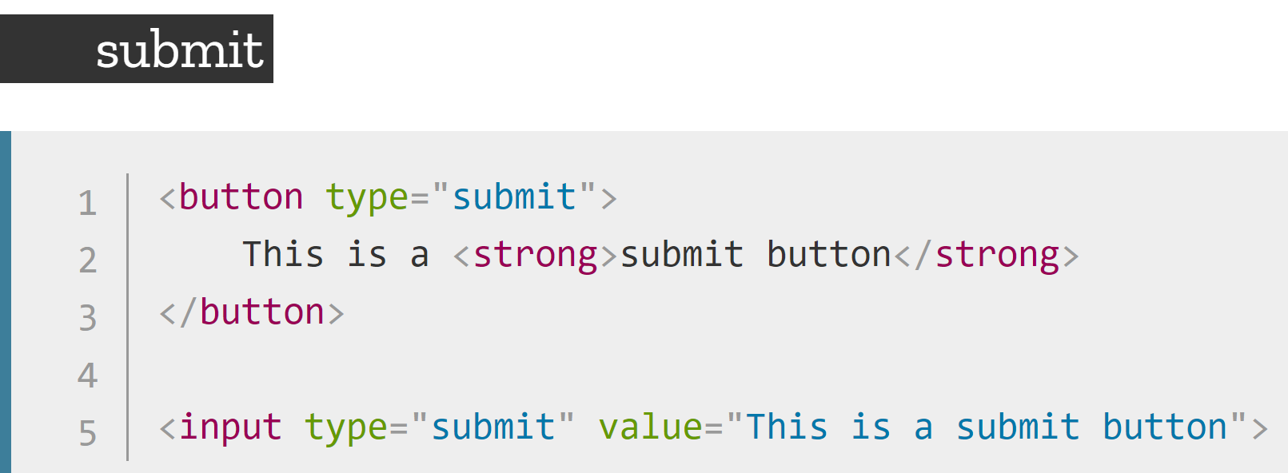
Actual buttons
Actual Buttons
Submit
Sends the form data to the server. For <button> elements, omitting the type attribute (or an invalid value of type) results in a submit button.
Reset
Resets all form widgets to their default values.
Button
Buttons that have no automatic effect but can be customized using JavaScript code.

Slide 20
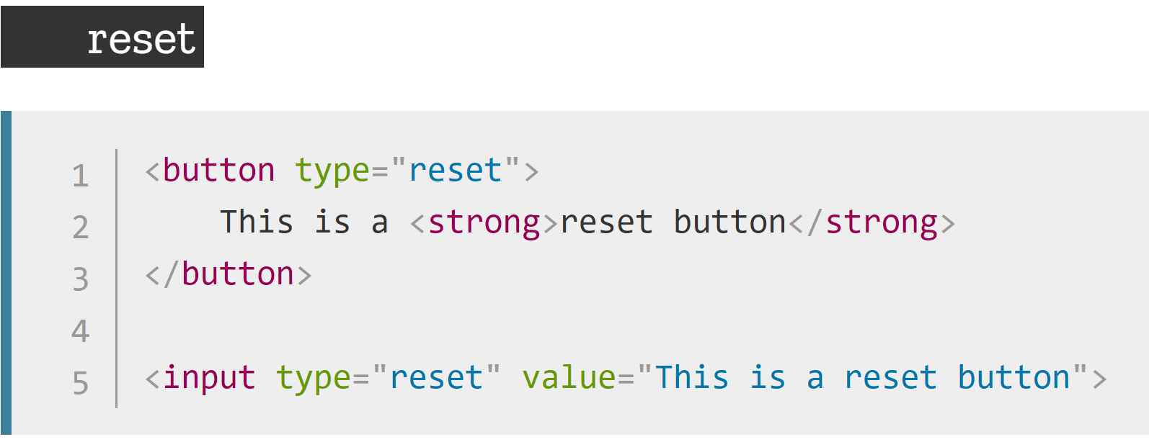
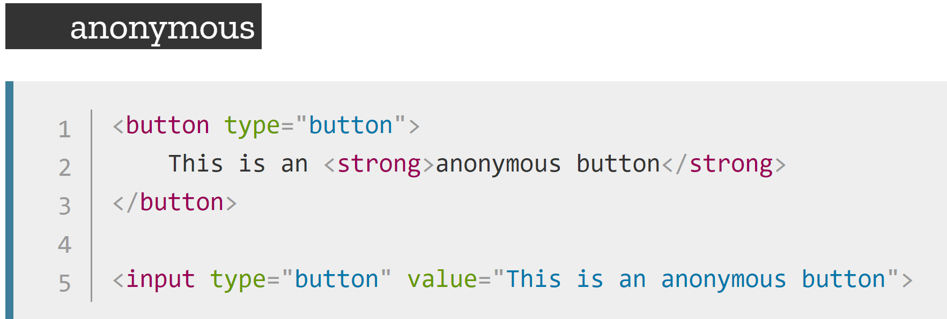
Actual buttons
Actual Buttons

Slide 21
File Picker
File Picker
There is one last <input> type that came to us in early HTML: the file input type. Forms are able to send files to a server
To create a file picker widget, you use the <input> element with its type attribute set to file.
The types of files that are accepted can be constrained using the accept attribute. In addition, if you want to let the user pick more than one file, you can do so by adding the multiple attribute.

Slide 22
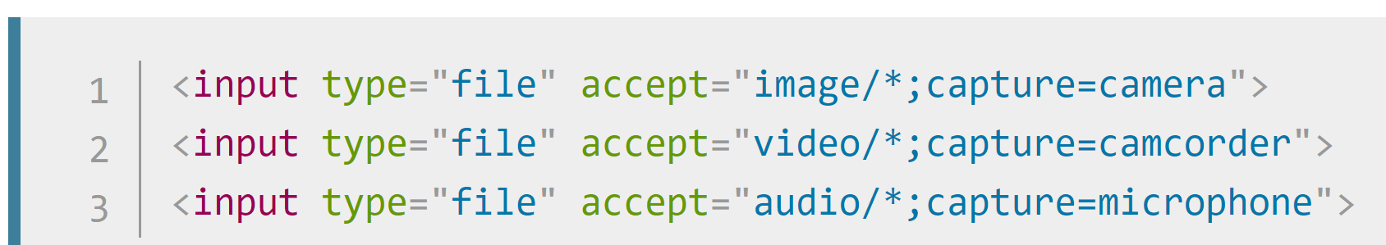
File Picker
File Picker
On some mobile devices, the file picker can access photos, videos, and audio captured directly by the device's camera and microphone by adding capture information to the accept attribute like so:

Slide 23
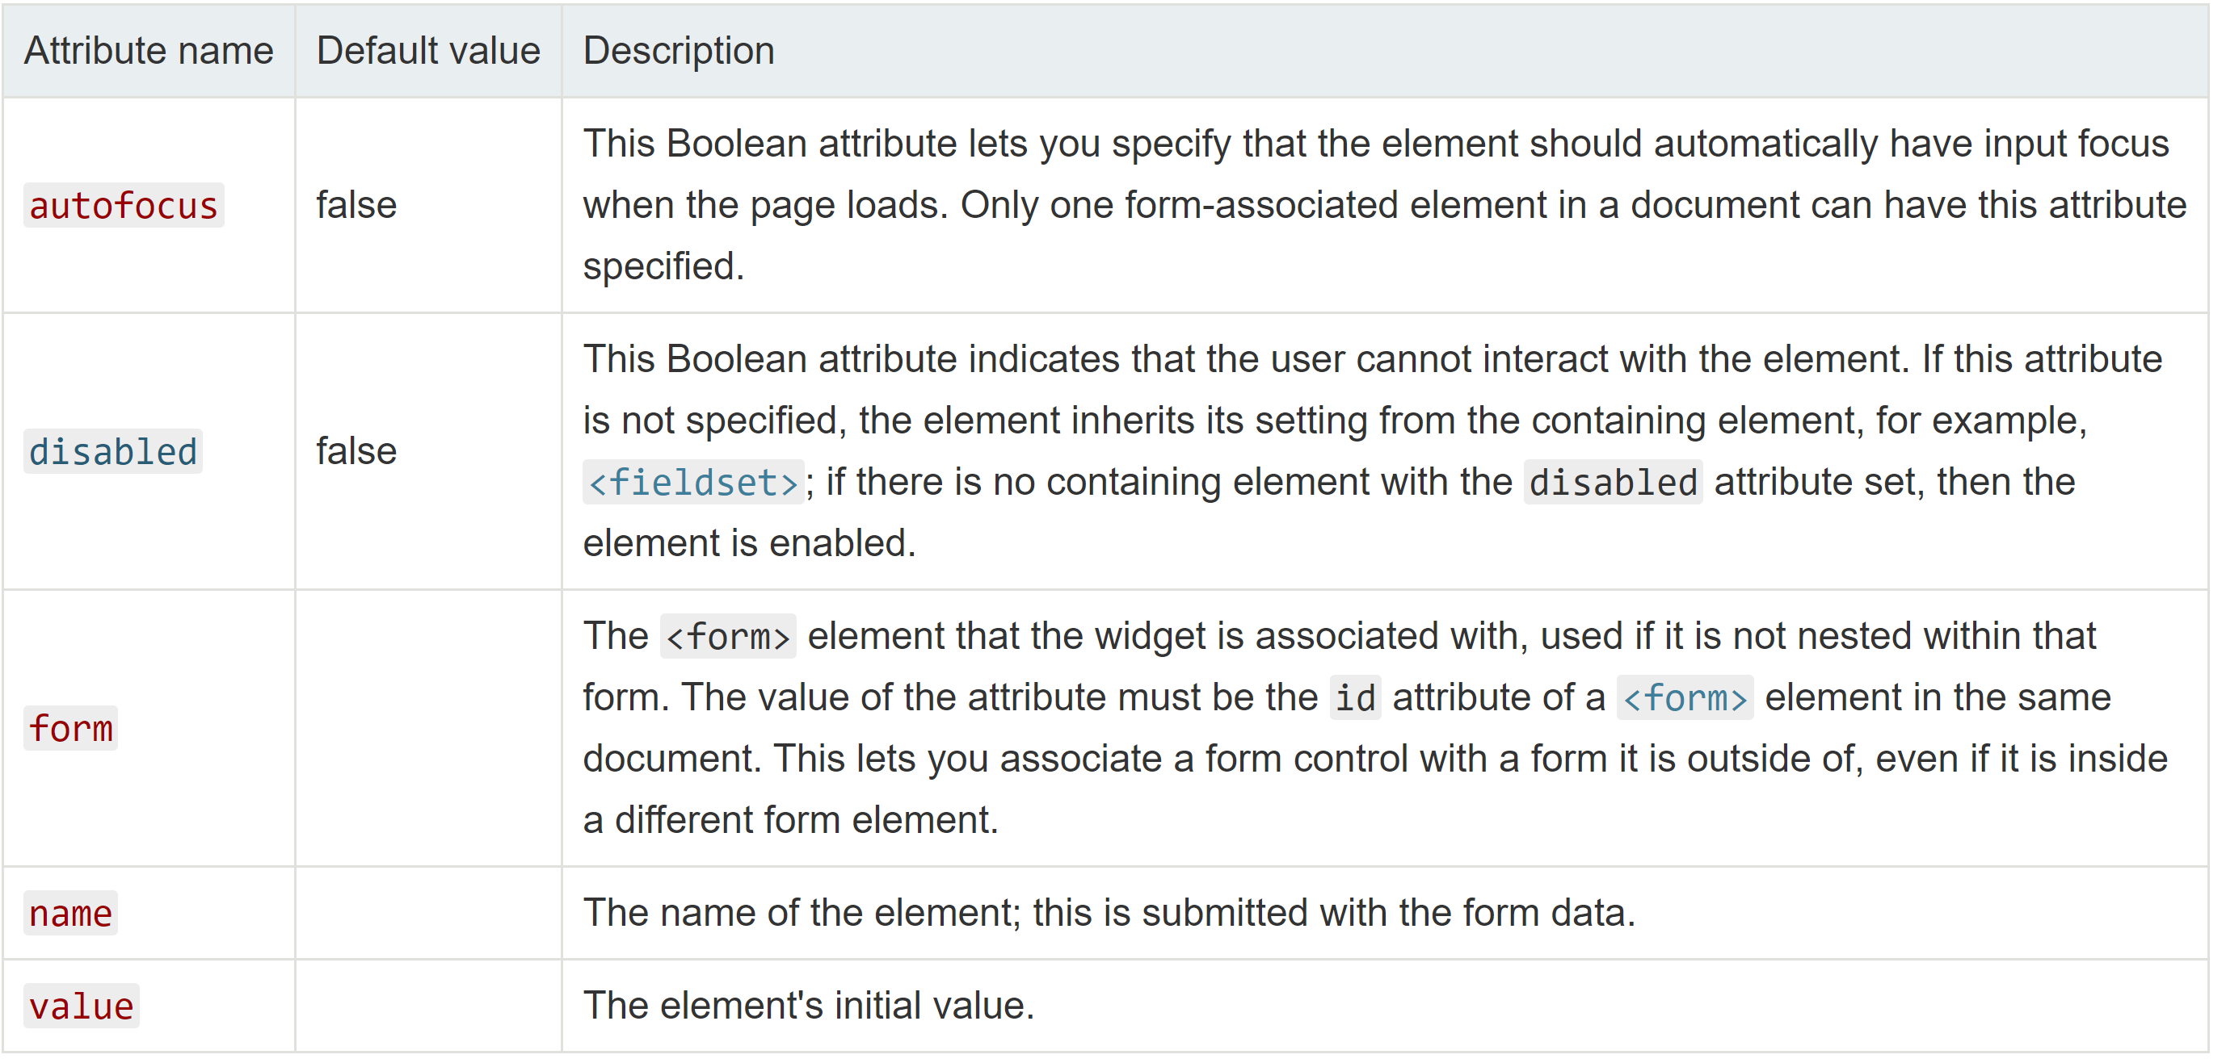
Common Attributes
Common Attributes

Slide 24
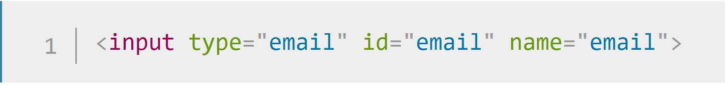
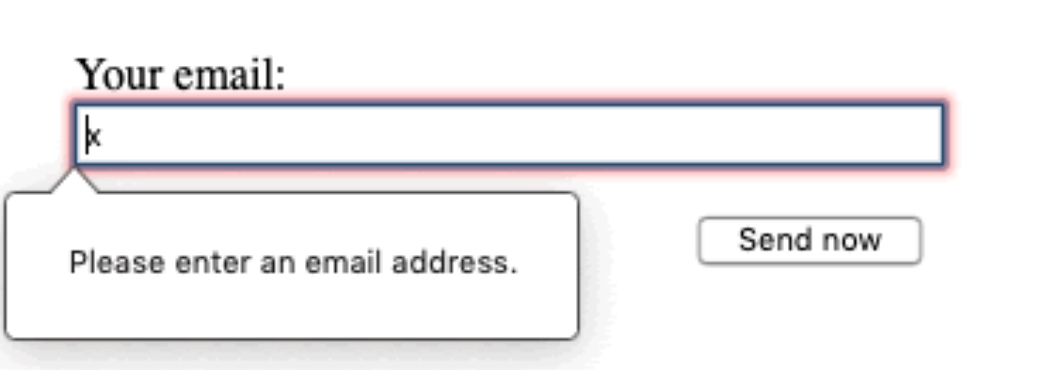
Email-Address Field
Email-address field
This type of field is set using the value email for the type attribute:
When this type is used, the user is required to type a valid email address into the field. Any other content causes the browser to display an error when the form is submitted.

Slide 25
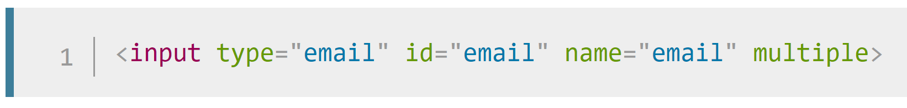
Email-Address Field
Email-address field
You can also use the multiple attribute in combination with the email input type to allow several email addresses to be entered in the same input (separated by commas):

Slide 26
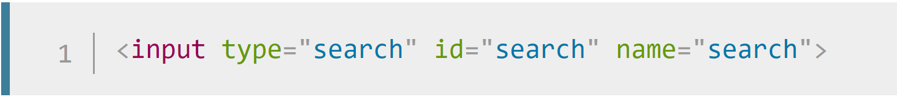
Search Field
Search field
Search fields are intended to be used to create search boxes on pages and apps. This type of field is set by using the value search for the type attribute:

Slide 27
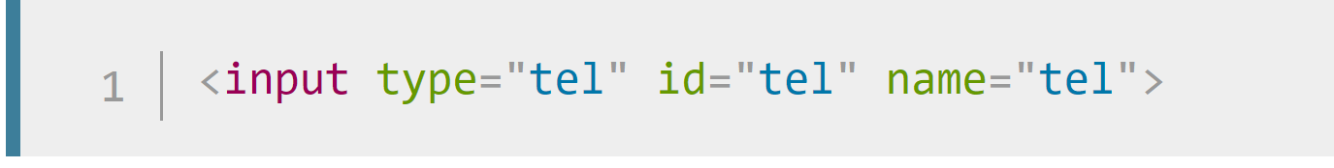
Phone Number Field
Phone number field
A special field for filling in phone numbers can be created using tel as the value of the type attribute:

Slide 28
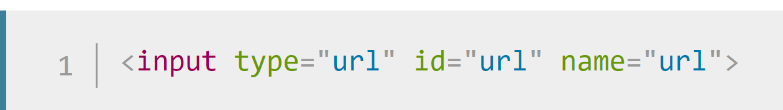
URL Field
URL field
A special type of field for entering URLs can be created using the value url for the type attribute:
It adds special validation constraints to the field. The browser will report an error if no protocol (such as http:) is entered, or if the URL is otherwise malformed.

Slide 29
Numeric Field
Numeric field
Controls for entering numbers can be created with an <input> type of number.
This control looks like a text field but allows only floating-point numbers, and usually provides buttons in the form of a spinner to increase and decrease the value of the control.
With the number input type, you can constrain the minimum and maximum values allowed by setting the min and max attributes
You can also use the step attribute to set the increment increase and decrease caused by pressing the spinner buttons

Slide 30
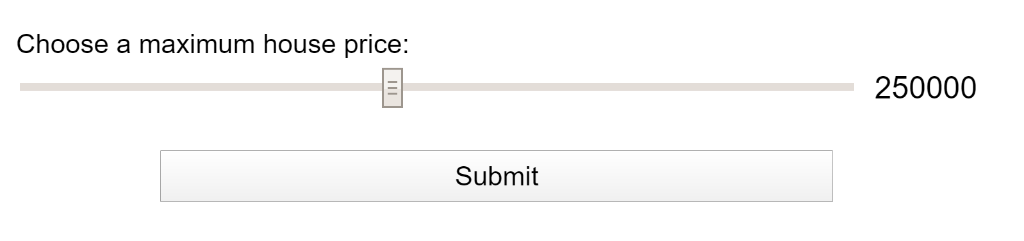
Slider Controls Field
Slider controls
Another way to pick a number is to use a slider. You see these quite often on sites like housebuying sites where you want to set a maximum property price to filter by. Let's look at a live example to illustrate this
A slider is created using the <input> with its type attribute set to the value range. The slider-thumb can be moved via mouse or touch, or with the arrows of the keypad.
It's important to properly configure your slider. To that end, it's highly recommended that you set the min, max, and step attributes which set the minimum, maximum and increment values, respectively.

Slide 31
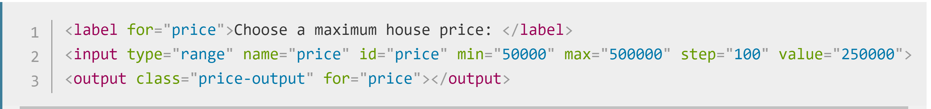
Slider Controls Field
Slider controls
This example creates a slider whose value may range between 50000 and 500000, which increments/decrements by 100 at a time. We've given it default value of 250000, using the value attribute.
One problem with sliders is that they don't offer any kind of visual feedback as to what the current value is. This is why we've included an <output> element — to contain the current value

Slide 32
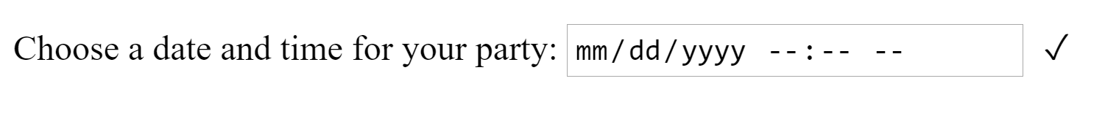
Date and Time Picker Field
Date and time picker
A date and time control is created using the <input> element and an appropriate value for the type attribute, depending on whether you wish to collect dates, times, or both. Here's a live example that falls back to <select> elements in non-supporting browsers:

Slide 33
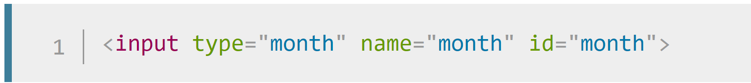
Date and Time Picker Field
Date and time picker
<input type="datetime-local"> creates a widget to display and pick a date with time with no specific time zone information.
<input type="month"> creates a widget to display and pick a month with a year.

Slide 34
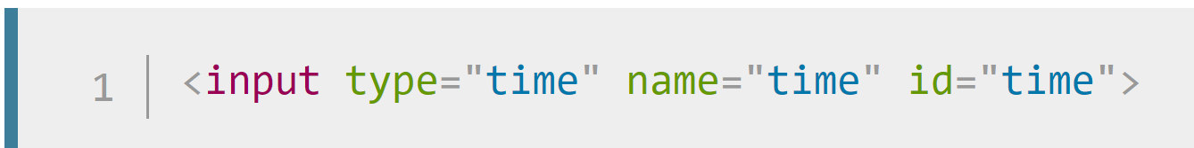
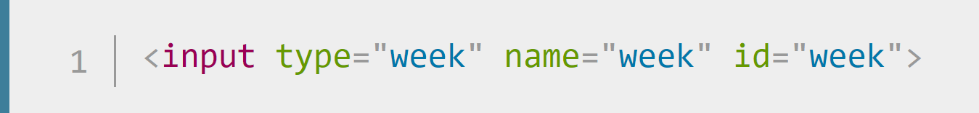
Date and Time Picker Field
Date and time picker
<input type="time"> creates a widget to display and pick a time value. While time may display in 12-hour format, the value returned is in 24-hour format.
<input type="week"> creates a widget to display and pick a week number and its year.

Slide 35
Date and Time Picker Field
Date and time picker
All date and time controls can be constrained using the min and max attributes, with further constraining possible via the step attribute (whose value is given in seconds).

Slide 36
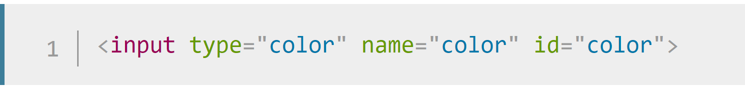
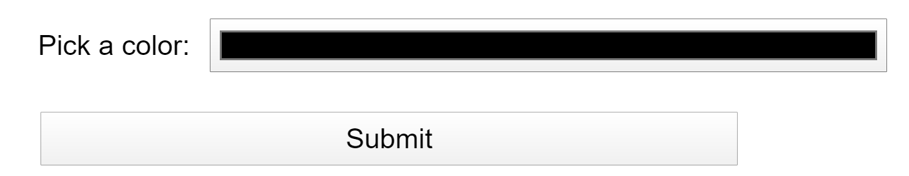
Color Picker Controls Field
Color Picker
Colors are always a bit difficult to handle. There are many ways to express them: RGB values (decimal or hexadecimal), HSL values, keywords, etc.
A color control can be created using the <input> element with its type attribute set to the value color:
When supported, clicking a color control will tend to display the operating system's default color picking functionality for you to actually make your choice with

Slide 37
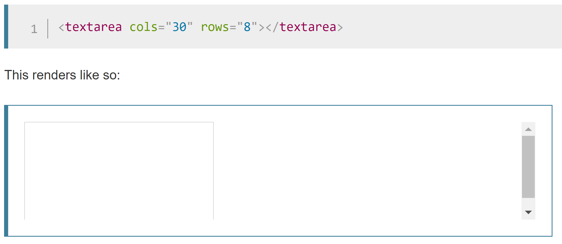
Multiline textField
Multiline text field
A multi-line text field is specified using a <textarea> element, rather than using the <input> element
When supported, clicking a color control will tend to display the operating system's default color picking functionality for you to actually make your choice with

Slide 38
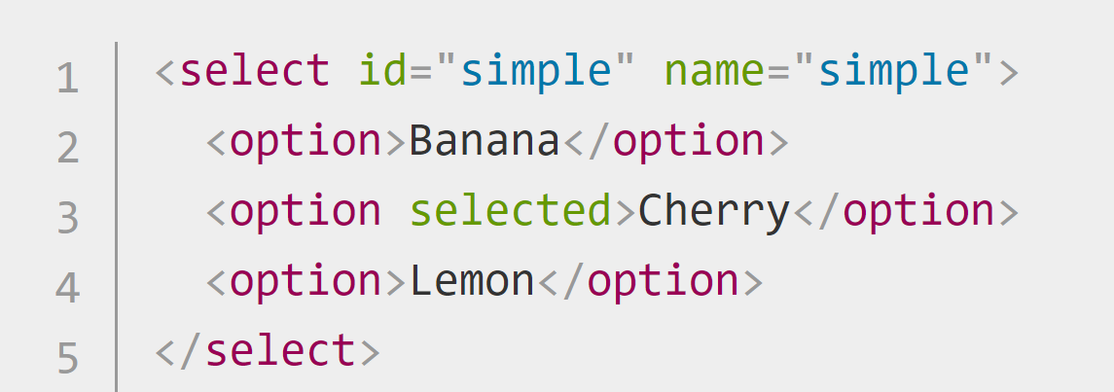
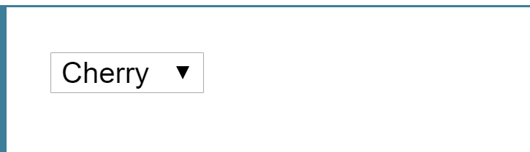
Drop Down Controls
HTML has two forms of drop down content: the select box, and the autocomplete box.
Select box
A simple select box is created with a <select> element with one or more <option> elements as its children, each of which specifies one of its possible values.

Slide 39
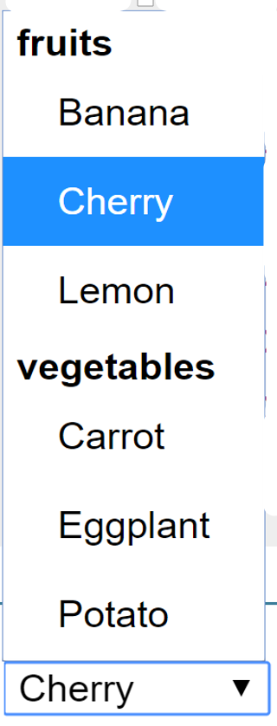
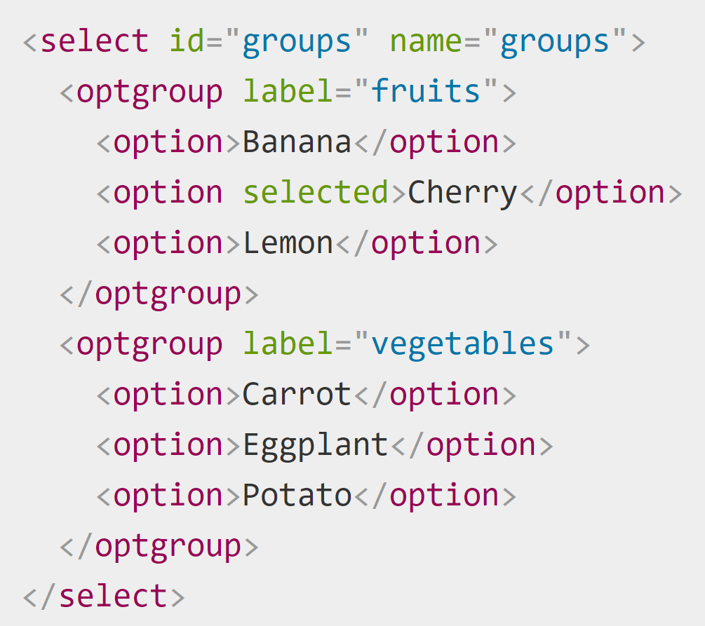
Drop Down Controls
If required, the default value for the select box can be set using the selected attribute on the desired <option> element — this option is then preselected when the page loads.
The <option> elements can be nested inside <optgroup> elements to create visually associated groups of values:

Slide 40
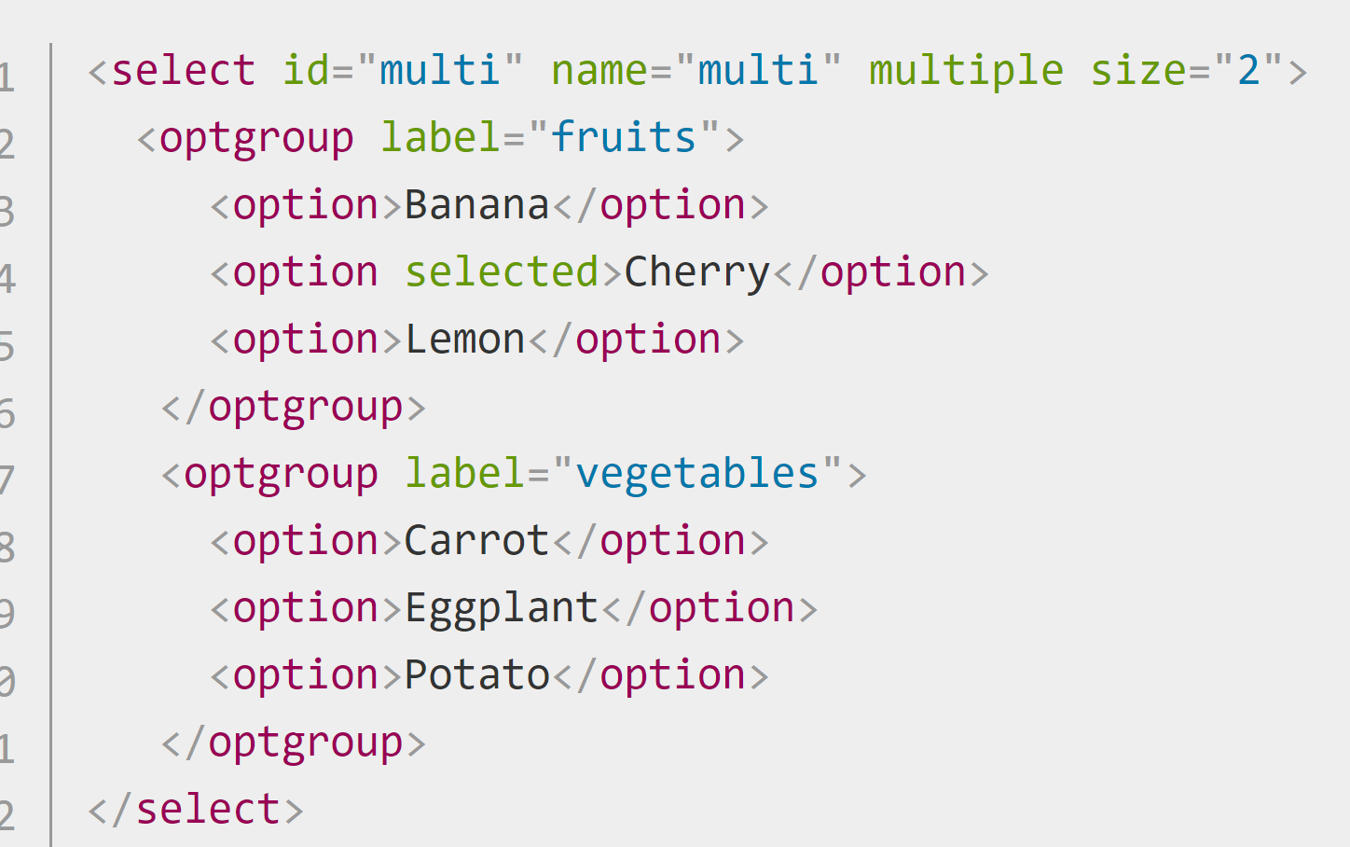
Drop Down Controls
Multiple choice selection box
By default, a select box only lets the user select a single value. By adding the multiple attribute to the <select> element, you can allow users to select several values, by using the default mechanism provided by the operating system (e.g. holding down Cmd/Ctrl and clicking multiple values on desktop).

Slide 41
Drop Down Controls
Autocomplete box
You can provide suggested, automatically-completed values for form widgets using the <datalist> element with child <option> elements to specify the values to display.
The <datalist> needs to be given an id.
The data list is then bound to an <input> element (e.g. a text or email input type) using the list attribute, the value of which is the id of the data list to bind.
Once a data list is affiliated with a form widget, its options are used to auto-complete text entered by the user; typically, this is presented to the user as a drop-down box listing possible matches for what they've typed into the input.

Slide 42
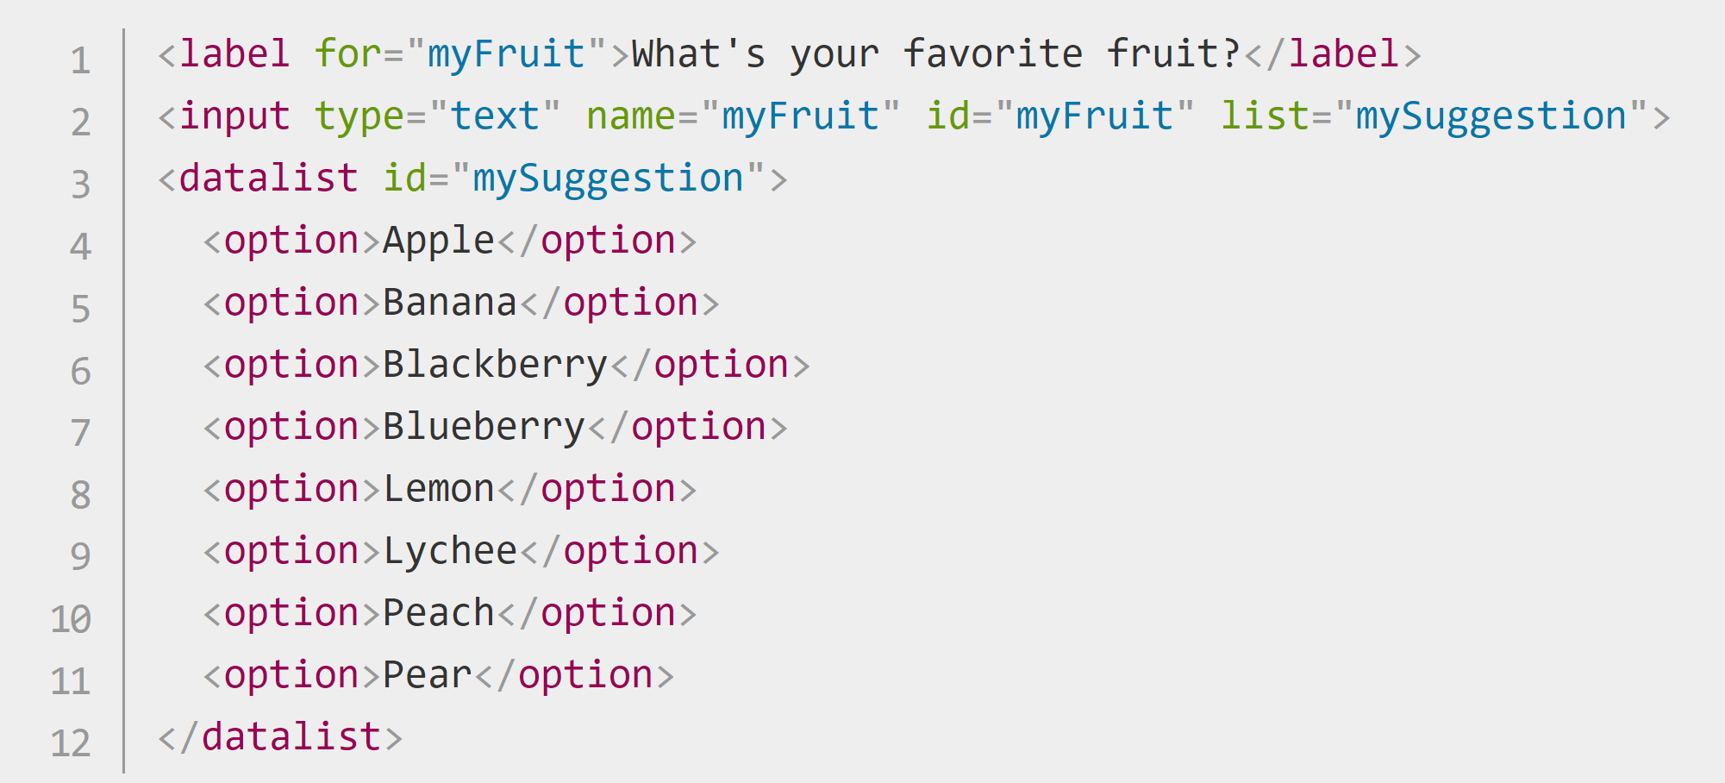
Drop Down Controls
Autocomplete box

Slide 43
Questions

Slide 44
Assignment

Slide 45
Assignment
In your pictures.html page, add the following:
Images
Video and audio content (of your choice)
Responsive images
Vector graphics
DUE IN THE NEXT LAB CLASS

